Slide 1
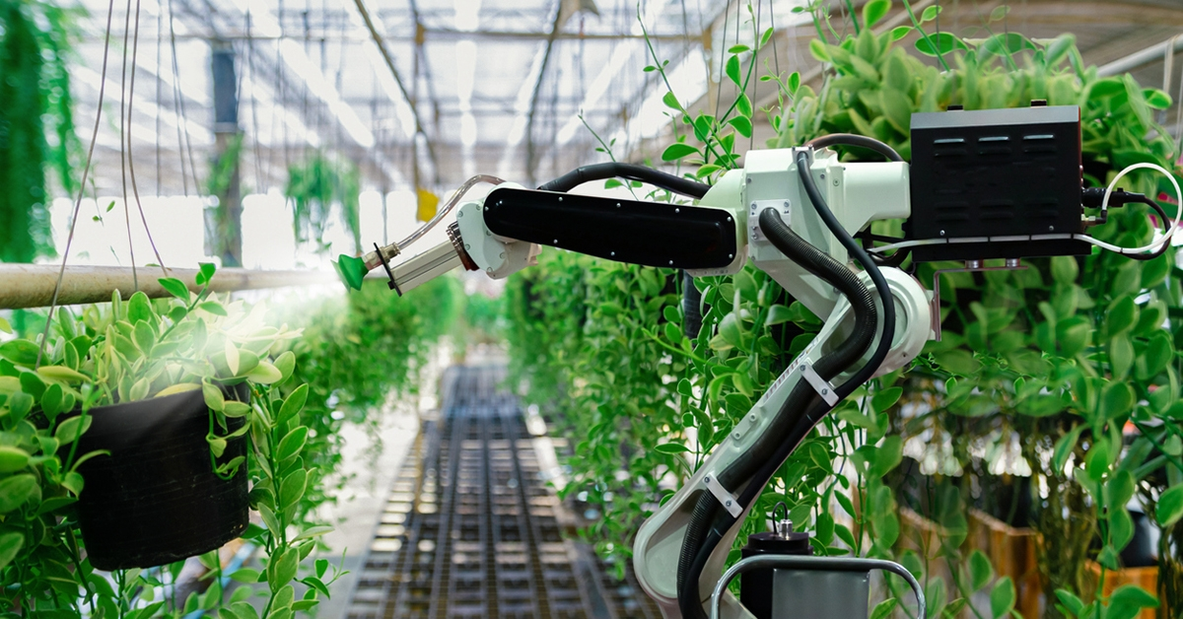
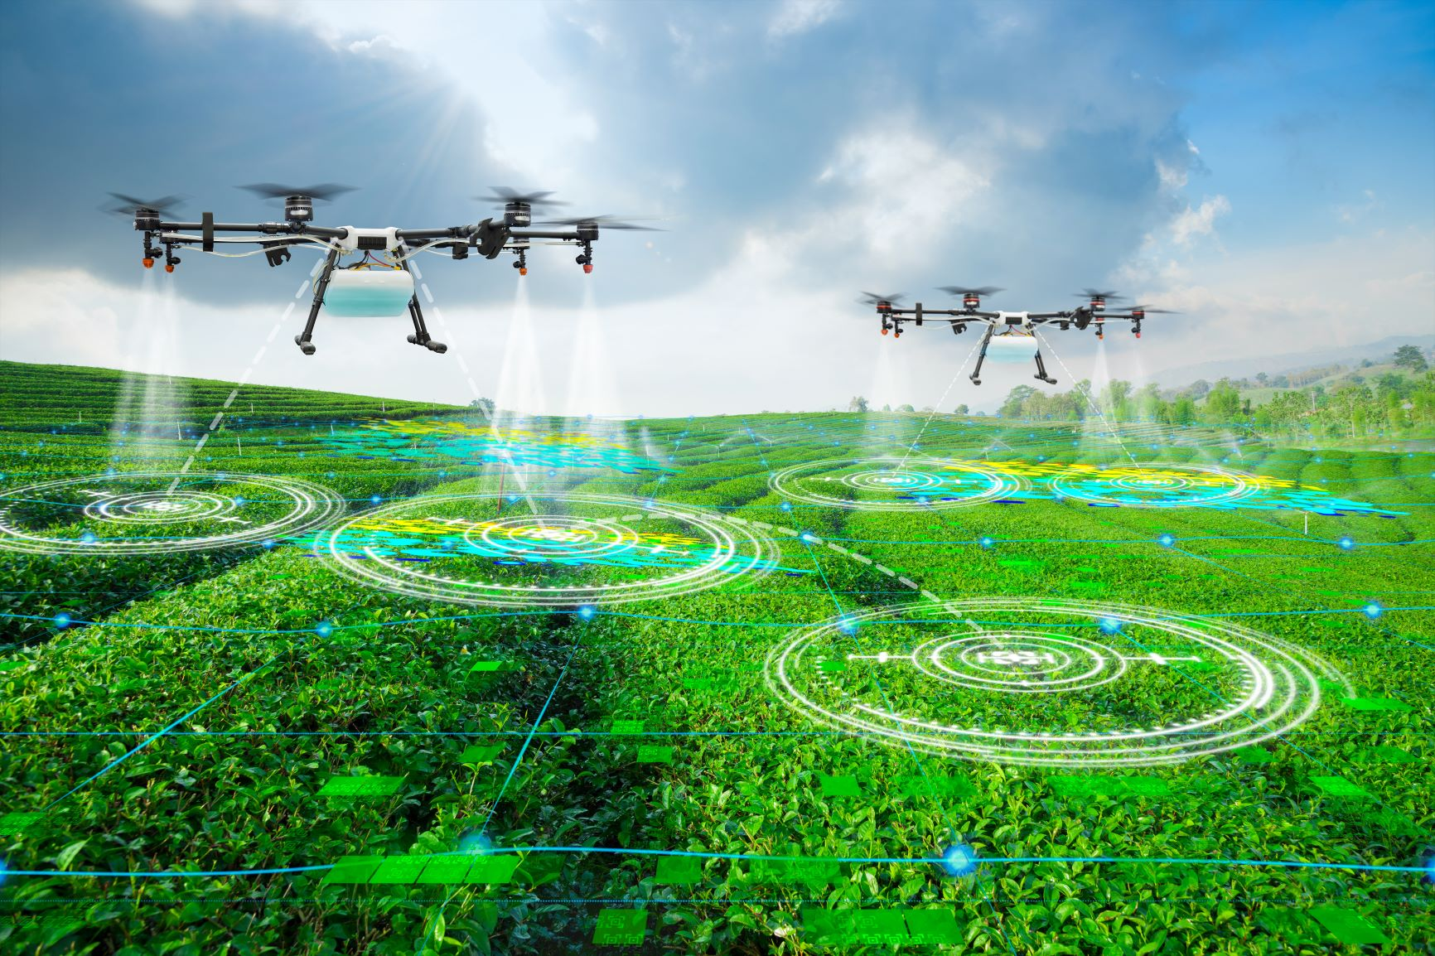
AI Applications in Agriculture
Team 14 – Anna Williams, Lonica McKinney, Nat Raudenbush and Gianni Baz
Notes:
https://th.bing.com/th/id/OIP.sb81F0_hjaPtkEpqGZuyxwHaD4?rs=1&pid=ImgDetMain
https://optical-tech-group.toyotec.com/wp-content/uploads/2021/01/29_1-scaled.jpg

Slide 2
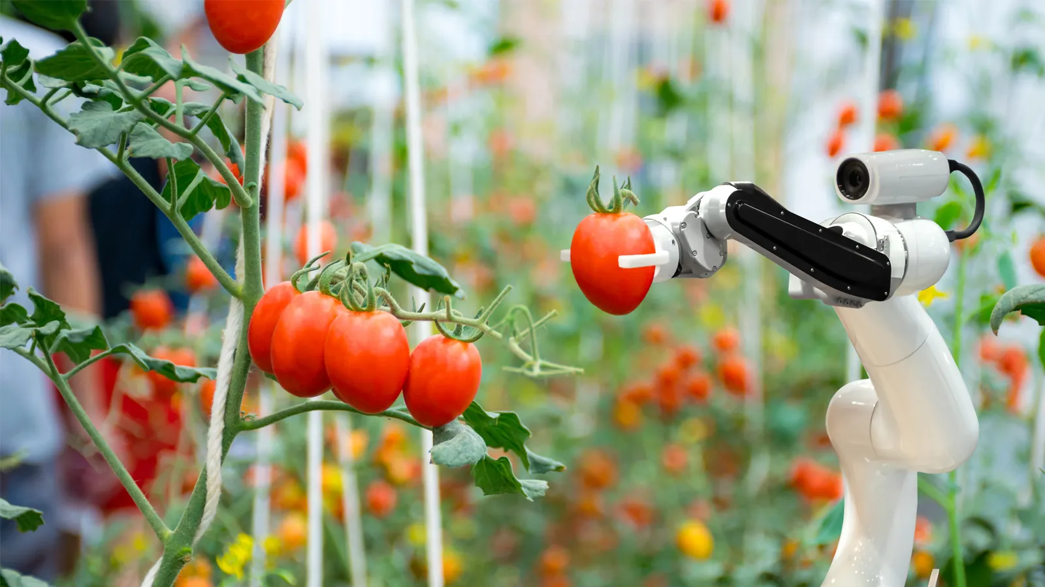
Problem Statement
How can we use AI applications to determine if agricultural produce is free of defects, ripe and in prime condition to sell/consume?
Class relevance:
Can use computer vision + our many different models to determine how to accurately predict the tomato classification
Notes:
https://www.mobilenews.hsbc.com/wp-content/uploads/2020/08/200812-through-the-eyes-of-a-robot-1600x900-1.jpg

Slide 3
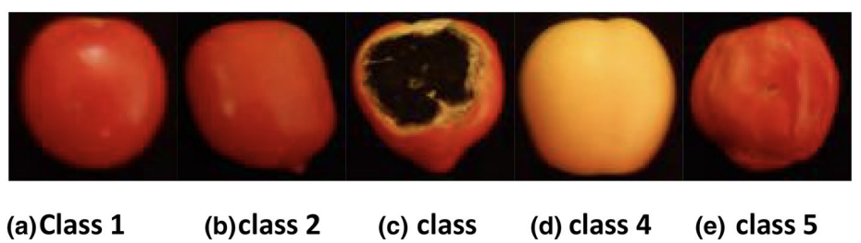
Research Paper: Comparison between soft computing methods for tomato quality grading using machine vision
Setup
From Journal of Food Measurement and Characteristic
Motivation of Study:
To design an accurate system that uses different AI models to help farmers and customers predict defects and classify tomatoes correctly
Data Set:
Used a data set from a farm in a village in Iran
840 images - classified into 7 categories
Inputs - 7(radius, difference between red/green/blue intensity, image entropy, boundary length)
Outputs - 5 classes (circular red, circular green, decayed, non-red premature, red w/ bad tissue)

Slide 4
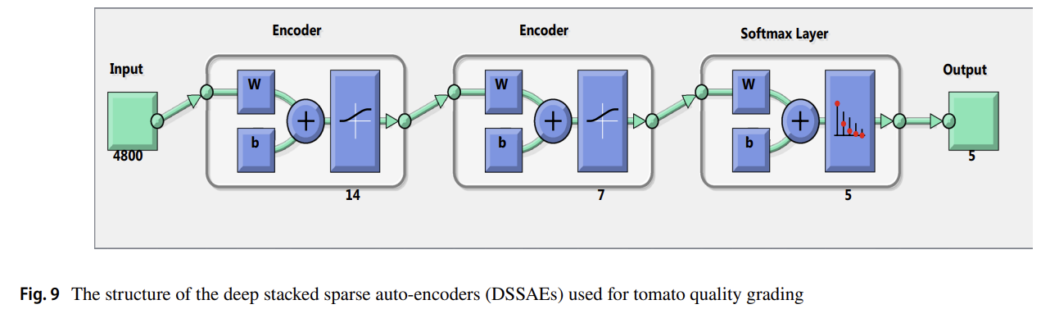
Research Paper Methods
Utilized pattern neural networks and scaled conjunction gradient backpropagation – 5 neurons in output layer for 5 classes
ELM(wave kernel), (base), (RBF kernel) - type of neural network that specifies input randomly and output analytically
Regression
Basic neural network
Deep Learning in form of deep stacked sparse autoencoders (DSSAEs) - multi-layer (what we learned)
Adaptive neuro-fuzzy inference system (ANFIS) - assumes a linear relationship between inputs and outputs and uses fuzzy operator for output production (a bunch of if then rules basically)
One with one and one with 2
Performed each one 100 times getting average accuracy, RMSE and confusion matrix.

Slide 5
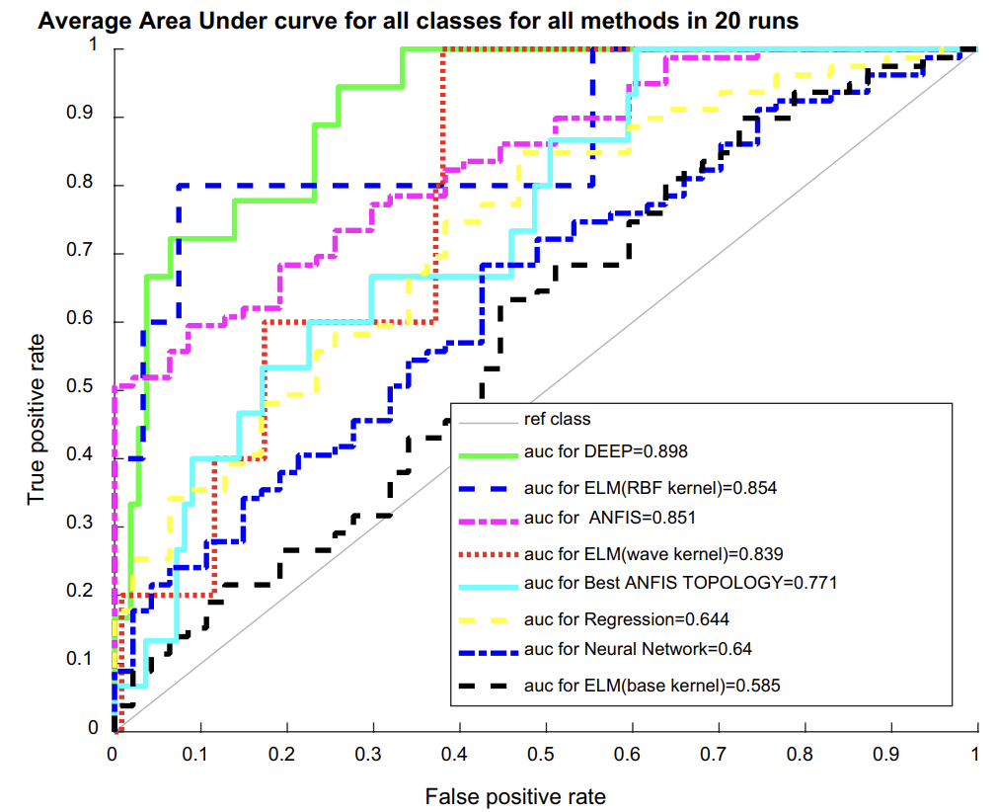
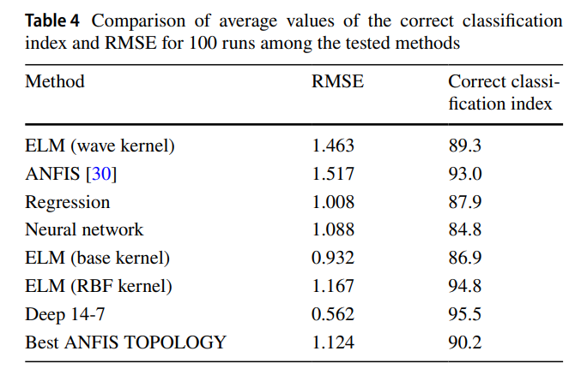
Conclusion Research Paper
(DSSAEs) or deep learning models proved to be the
most effective method
Highest RMSE, correct classification, best sensitivity/specificity, area under curve
Capable of classifying directly from tomato image data without the application of image processing techniques to extract features

Slide 6
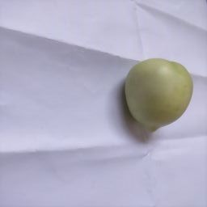
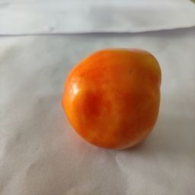
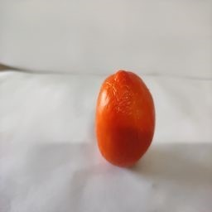
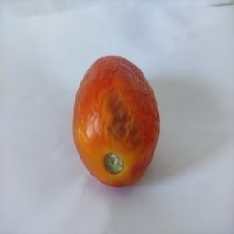
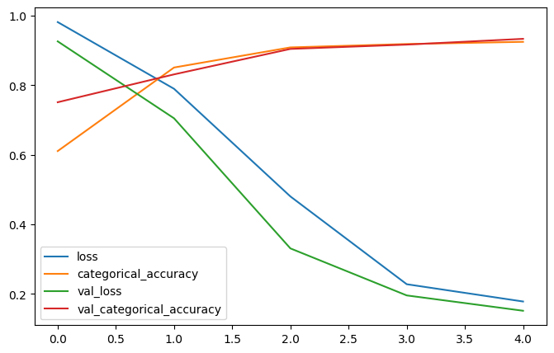
Coding Demo
Dataset - Tomatoes Dataset (Kaggle)
7226 Images (6500 train, 724 validation),
4 classes - Ripe, Unripe, old, damages
Model - VGG16
Transfer learning model comprised of 13 convolutional layers plus 3 fully connected layers
Weights: imagenet
Fit over 5 epochs
Accuracy: 93%
Potential Future Expansion
Training longer with more epochs
Trying different hyperparameters or different model structures
Using more images that are on the vine or in bulk post harvesting

Slide 7
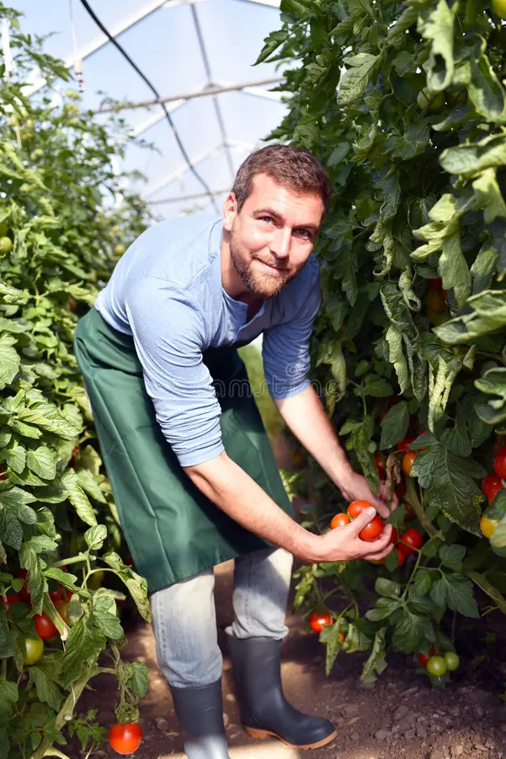
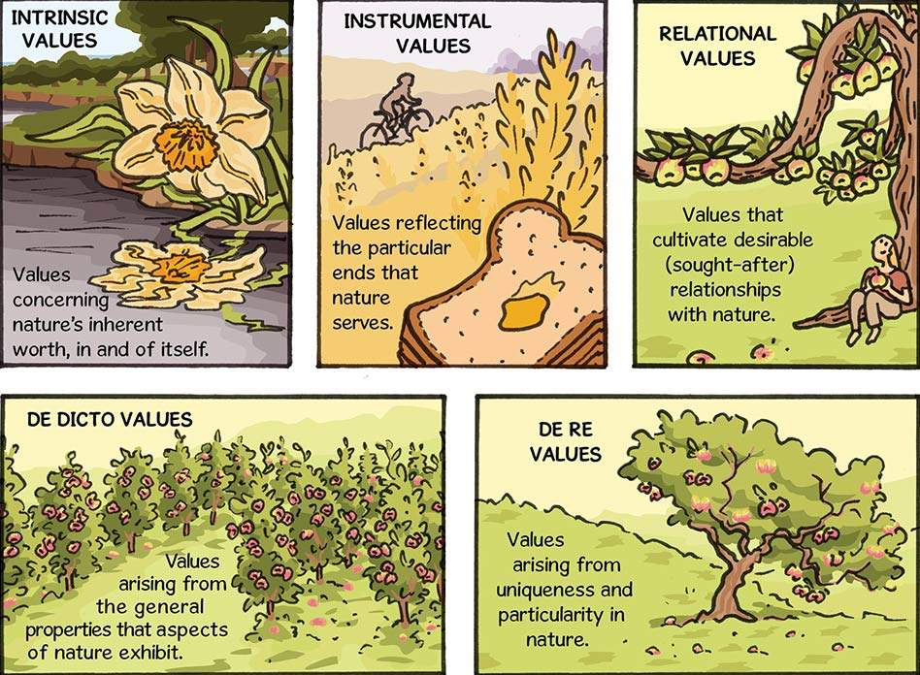
Ethical Concerns
Impact on employment – “eventually avoiding the need for a human expert.”
Bias and fairness – intrinsic and extrinsic/instrumental values
Equitable access – small-scale farmers not left behind
Unforeseen long-term consequences
Regulatory compliance
Notes:
https://www.routledge.co.uk/rsc/images/crccms/blog/HSCX22SCI003-blog-948w-B-Nature_Can_We_Put_A_Value_On_It_Value_Definitions_.jpg
https://thumbs.dreamstime.com/b/happy-farmer-growing-tomatoes-greenhouse-closeup-photo-124252558.jpg

Slide 8
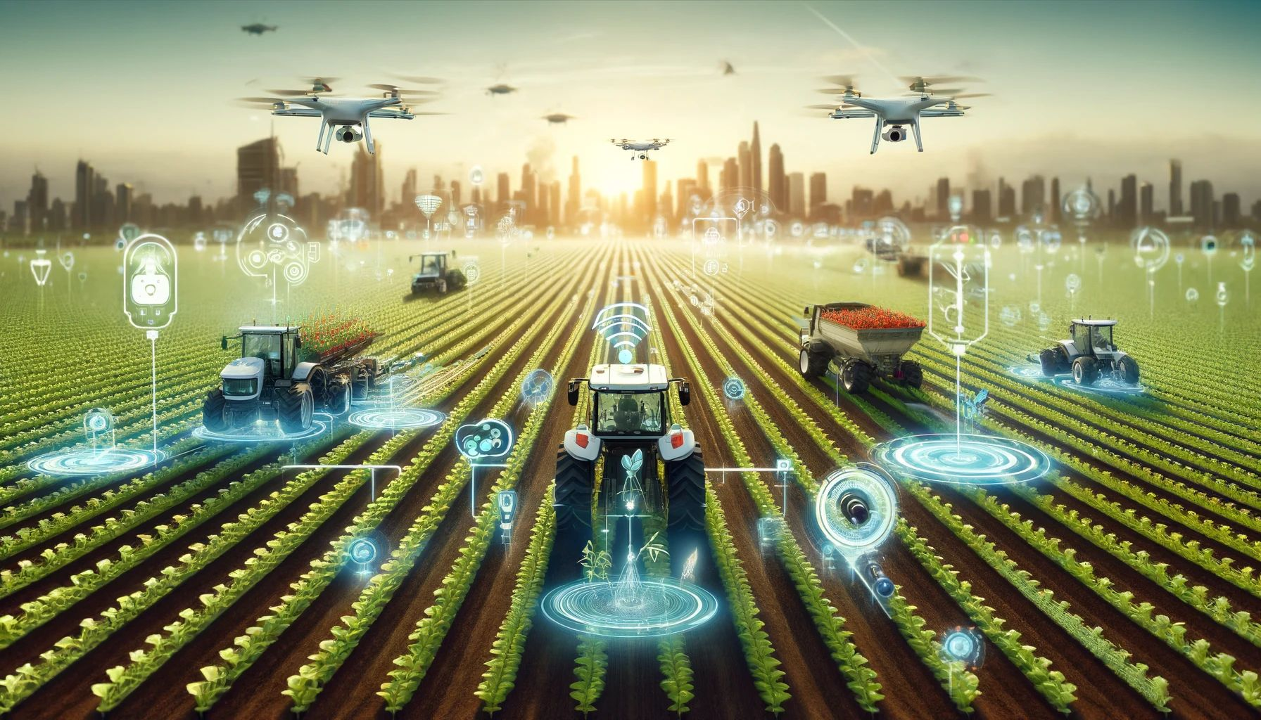
Future Developments + Concerns
It could be possible increase the accuracy of the model with a different deep learning network (e.g. Convolutional neural network)
More complex factors associated with quality evaluation were left out of the study and our coding demo, which serves as the primary limitation in our work.
The model is not 100% accurate, so it can only be used to aid decision making as opposed to running and classifying images independently.
Including the more complicated factors (different color models, accounting for standard deviation, skewness, etc.) should improve the model’s accuracy, eventually to the point where human intervention isn’t necessary.
Notes:
https://www.linkedin.com/posts/yuryshamrei_the-future-of-farming-where-iot-ai-and-activity-7184128078565015552-nd8n/

Slide 9
Citations
https://link.springer.com/article/10.1007/s11694-018-9913-2
https://th.bing.com/th/id/OIP.sb81F0_hjaPtkEpqGZuyxwHaD4?rs=1&pid=ImgDetMain
https://optical-tech-group.toyotec.com/wp-content/uploads/2021/01/29_1-scaled.jpg
https://www.mobilenews.hsbc.com/wp-content/uploads/2020/08/200812-through-the-eyes-of-a-robot-1600x900-1.jpg
https://www.routledge.co.uk/rsc/images/crccms/blog/HSCX22SCI003-blog-948w-B-Nature_Can_We_Put_A_Value_On_It_Value_Definitions_.jpg
https://thumbs.dreamstime.com/b/happy-farmer-growing-tomatoes-greenhouse-closeup-photo-124252558.jpg
https://www.linkedin.com/posts/yuryshamrei_the-future-of-farming-where-iot-ai-and-activity-7184128078565015552-nd8n/

